Slide 1
Random Forest

Slide 2
Random Forest
Introduction
Motivation
Pros and cons
When should we use
We’ll be discussing every topic in the aspect of a final project
Final project is to classify the Titanic data

Slide 3
Random Forest
Motivation
Like all analyses tools, the random forest is a predictive analysis.
Random Forest is an analysis to conduct when the dependent variable is binary or multi-class.
Supervised Machine Learning Algorithm
Random Forest uses votes of trees for predictions

Slide 4
Random Forest
How Algorithm works
- Select random samples from a given dataset.
- Construct a decision tree for each sample and get a prediction result from each decision tree.
- Perform a vote for each predicted result.
- Select the prediction result with the most votes as the final prediction.

Slide 5
Random Forest
Pros and cons
Pros
No chance of overfitting since it takes average of all predictions
Random Forest can be used for classification and regression both
Algorithm helps us getting the most important features of out dataset
Cons
Random Forest is slow in making decisions because it has to calculate the prediction out of all the decision trees
Model is very complex to interpret since it has a whole structure of trees

Slide 6
Random Forest
When should we use
When we need to classify the data into two or more categories
When we need regression values from algorithm
When data is labeled
We can use random forest for almost every sort of labeled data

Slide 7
Random Forest
Final project
Introduction to dataset
Goals
Roadmap

Slide 8
Random Forest
Reading and manipulating the data
Pandas
Numpy
Reading and manipulating Titanic dataset

Slide 9
Random Forest
Pandas
Pandas contains data structures and data analysis tools for the Python programming language.
Pandas is a Python package providing fast, flexible, and expressive data structures designed to make working with “relational” or “labeled” data both easy and intuitive.

Slide 10
Random Forest
Numpy
NumPy is the fundamental package for scientific computing with Python.
NumPy is a general-purpose array-processing package.
It provides a high-performance multidimensional array object, and tools for working with these arrays.

Slide 11
Random Forest
Preparing data for Machine learning
Data visualization
Matplotlib
Data cleaning
Removing the outliers
Filling/removing missing values
Categorical to numeric conversion

Slide 12
Random Forest
Data visualization
Matplotlib
Matplotlib is a Python 2D plotting library which produces publication quality figures in a variety of hard copy formats and interactive environments across platforms.
Matplotlib can be used in Python scripts, the Python and IPython shells, the Jupyter notebook, web application servers, and four graphical user interface toolkits.
Matplotlib tries to make easy things easy and hard things possible. You can generate plots, histograms, power spectra, bar charts, error charts, scatterplots, etc., with just a few lines of code

Slide 13
Random Forest
Data cleaning
Removing the outliers
An outlier can be a measurement error or data entry error.
Manually correct the outline if possible.
If you can’t fix it, remove that observation because you know it’s incorrect or it not a part of the population you are studying (i.e., unusual properties or conditions), you can legitimately remove the outlier.

Slide 14
Random Forest
Data cleaning
Filling/removing missing values
Missing data is the situation where some values of some cases are missing.
Some fix-up methods are:
Delete the row with missing observations.
Manually fill-in or impute the missing values.

Slide 15
Random Forest
Data cleaning
Categorical to numeric conversion
Machine only understands numeric values
We have to convert categorical(non-numeric) values to numeric values such that they do not lose their essence
For example: Sex

Slide 16
Random Forest
A quick implementation
Implementing sklearn’s random forest model
Are you curious enough to know what is going behind the scenes?
It will help you to tune the performance of your model according to your projects

Slide 17
Random Forest
Complete implementation
Without using any python library(except pandas, just to read the data)
Everything will be implemented from scratch
Get to know that what is going behind the scenes in sklearn’s implementation of Random Forest

Slide 18
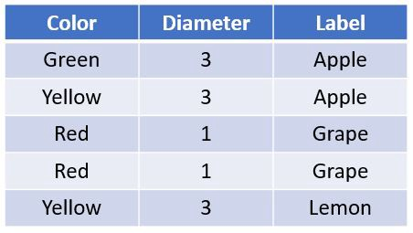
Random Forest
Structure
Forest
Tree
Leaf Node
Decision Node

Slide 19

Random Forest
Impurity
Amount of Randomness in data set
Impurity should be minimum in a good data set
Formula

Slide 20
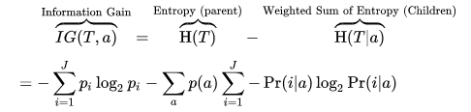
Random Forest
Information Gain
How much information can be gained by splitting on certain column
We’ll select such value for column as question where IG is maximum
Formula

Slide 21
Random Forest
How to find best split
At any decision node, where information gain is maximum
Split the tree into two branches
True Branch
False Branch

Slide 22
Random Forest
Classifying
Recursive call for prediction
Get a prediction
Validate the prediction
Find Accuracy of model

Slide 23
Random Forest
Create a forest
Create one tree
Then create another one
And so on, create as many trees as needed
Benefits
Voting
Decisions

Slide 24
Random Forest
Concluding
Further instructions to implement random forest on other data sets
Answers to frequently asked questions

Slide 25
Random Forest
Further installations to implement random forest on other data sets
Get the labeled dataset
Remove outliers
Fill/remove missing values
Normalize the data
Train the model
Test the model
validation

Slide 26
Random Forest
Answers to frequently asked questions
Is Random forest a supervised machine learning algorithm?
How can we use Random forest for Regression?
Is it possible to apply a random forest algorithm on a 3-class Classification problem?
Any other question?

